Slide 1

تراث - Turath
Training Company: AST Group Code: SHR1_SWD4_S1e

Slide 2

Introducing Turath - A Historical Events and Figures Application
Turath is a comprehensive application that brings history to life, providing users with a wealth of information on significant events and influential figures from the past. With features like historical book and artifact purchases, as well as an engaging community section, Turath offers a unique and immersive experience for history enthusiasts.

Slide 3
Meet the Turath Team
Karim Ahmed Mohamed Rashad
Hassan Alaa Hassan
ID: 21025983
ID: ID: 21039009
Mariam Hany Aly Elsayed
Menna Abd Elmagid Mostafa Abd Elmagid
ID: 21051647
ID: 21018185

Slide 4

Technology Powering Turath
1
Dart
The primary programming language used for Turath's development.
2
Flutter Framework
Utilized for building the application's front-end user interface.
3
Firebase
Providing backend services such as authentication, data storage, and cloud functionalities.

Slide 5

Turath's Key Packages
1
google_sign_in
2
firebase_auth
Enables Google account login for Turath users.
Handles user authentication for the application.
3
cloud_firestore
4
shared_preferences
Manages and stores data in the cloud for Turath.
Stores user data locally on the device.

Slide 6




Features of Turath
Historical Information
Purchase Options
Interactive Community
Provides comprehensive details on significant historical events and influential figures.
Allows users to buy rare historical books and artifacts.
Includes a forum for discussions and debates on historical topics.

Slide 7
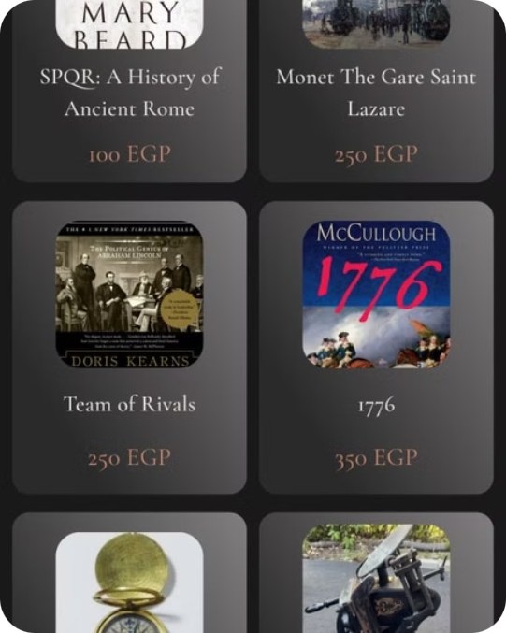
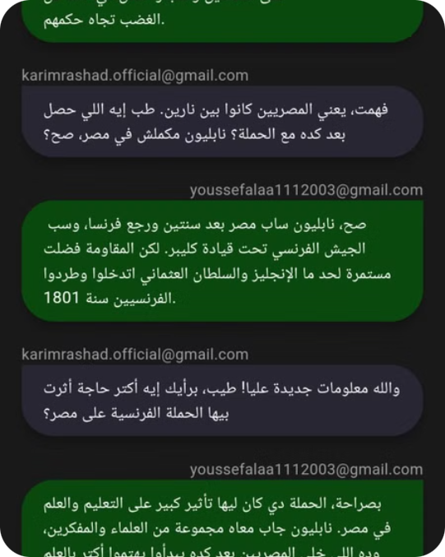
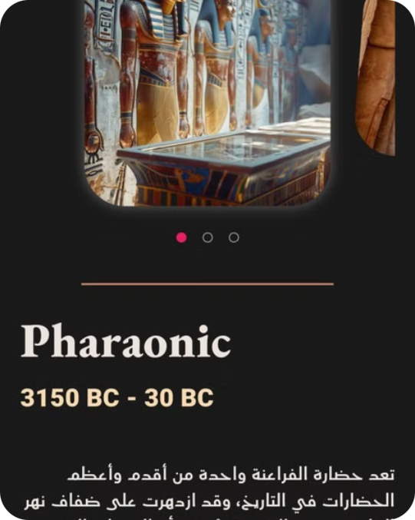
Bazar
Community
Civilizations

